Slide 1
COURSE NAME: Artificial intelligence
PROJECT: measure energy consumption
NAME: M.Vishnu priya

Slide 2
ABSTRACT :
An increase in consumption and inefficiency, fluctuating trends in demand and supply, and a lack of critical analytics for successful. management are just some of the problems that the energy business throughout the world is currently facing. This study set out to assess the potential contributions that Al and ML technologies could make to the expansion of energy production in developing countries, where these issues are more pronounced because of the prevalence of numerous. unauthorized connections to the electricity grid, where a large amount of energy is not being measured or paid for. This study primarily airns to address issues that arise due to frequent power outages and widespread lack of access to energy in a wide range of developing countries. Findings suggest that Al and ML have the potential to make major contributions to the fields of predictive turbine maintenance, energy consumption optimization, grid management, energy price prediction, and residential building energy demand and efficiency assessment. A discussion of what has to be done so that developing nations may reap the benefits of artificial intelligence and machine learning in the energy sector concluded the paper.

Slide 3

Title text addition
artificial intelligence is more than just a record of machines attempting to imitate or replace human intellect: rather, it is also a record of how our conception of intelligence has developed with time.
Title text
Title text

Slide 4
Title text addition
Systems that are capable of rational thought
Al systems that mimic human behavior
Simulations of human thought in machines
Systems that behave in a reasonable manner

Slide 5
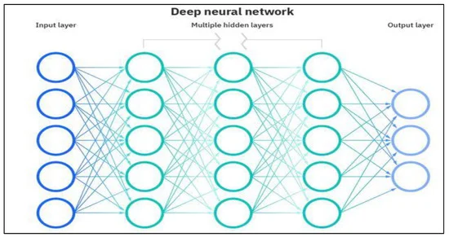
Deep neural algorithm

